Slide 1

Design UML Diagrams for AEIOU Productivity and Focus App
A systematic approach to visualising how the system supports task execution, focus sessions, and distraction control

Slide 2
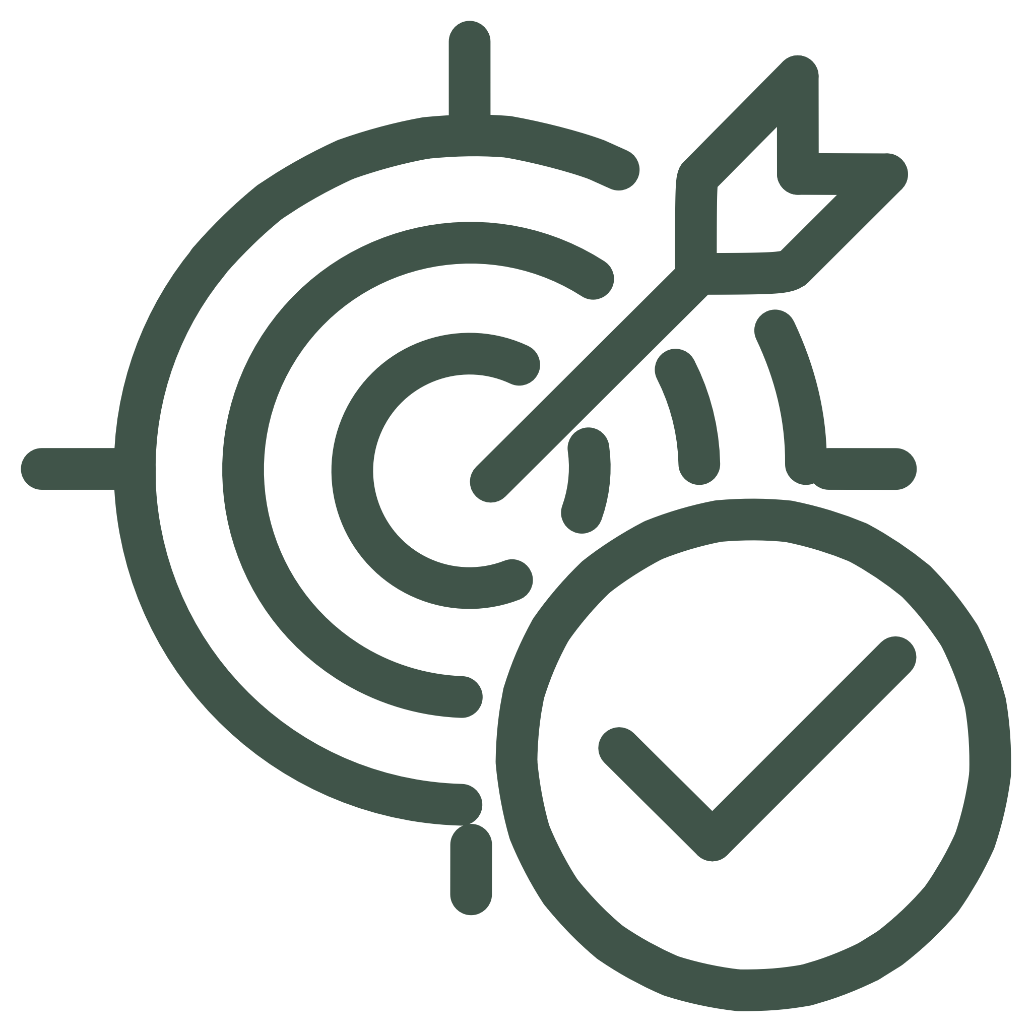
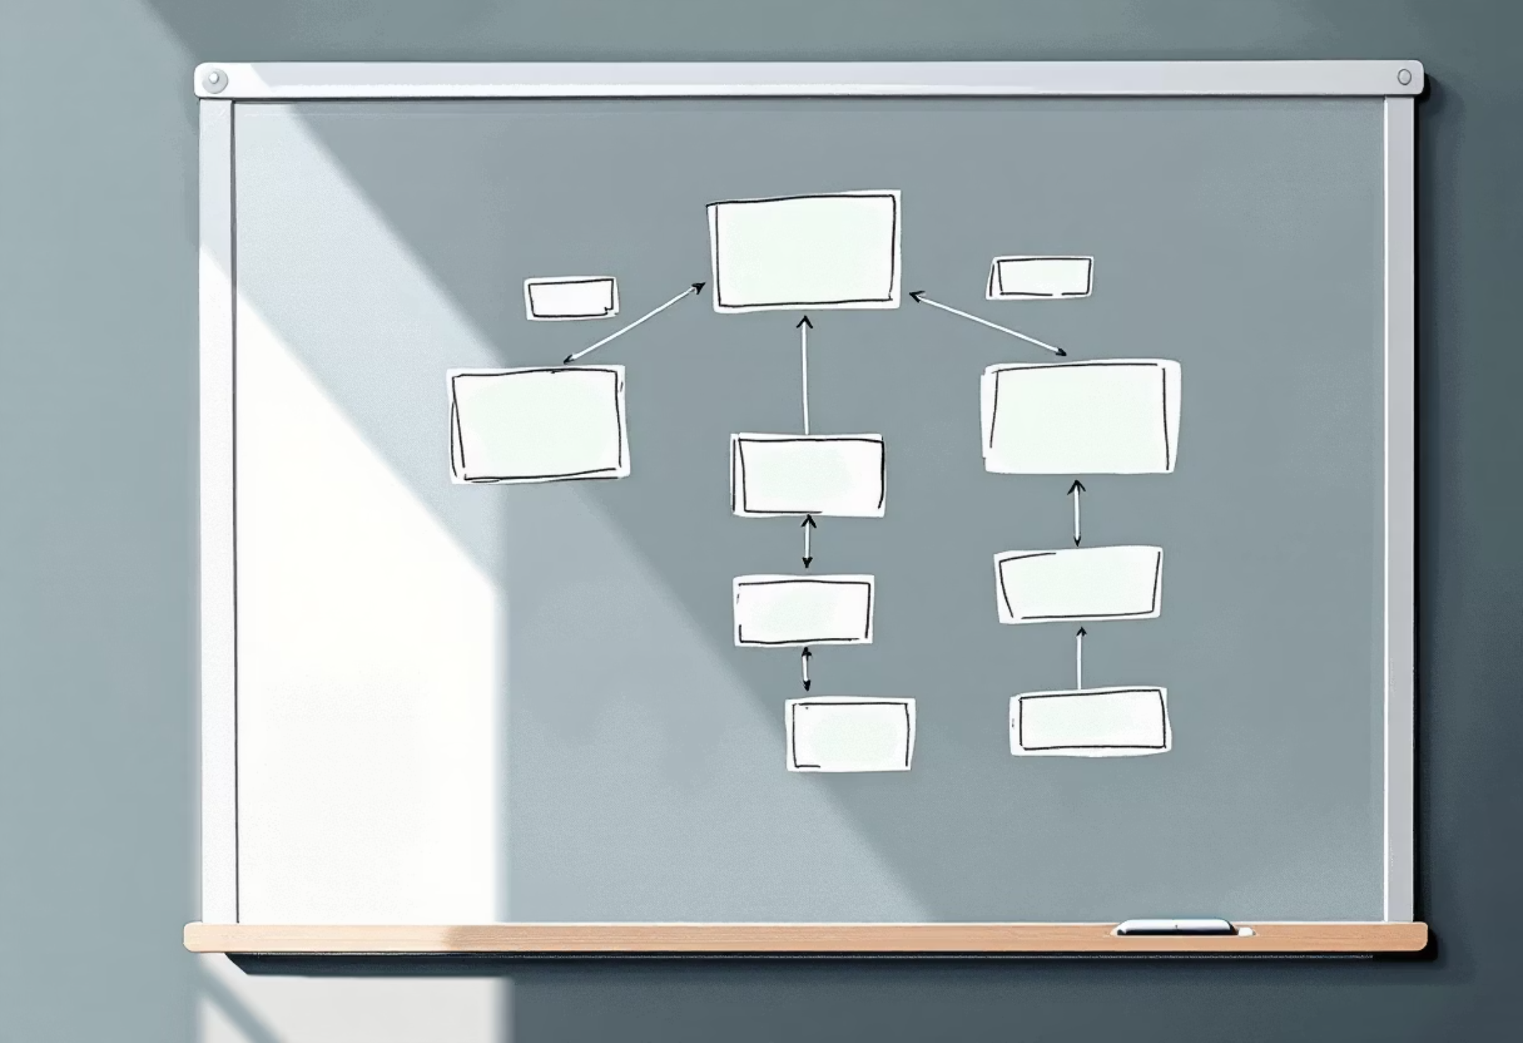

PROJECT AIM
Visualising System Behaviour Through UML
The primary aim of this project is to design comprehensive UML diagrams for the AEIOU Productivity and Focus App. These diagrams will illustrate how the system architecture supports users in executing tasks, maintaining focus sessions, and managing digital distractions effectively.
By creating clear visual representations, we enable developers and stakeholders to understand system interactions, workflows, and data flows at a glance.

Slide 3
The Problem We're Solving
Digital Distractions
Unstructured Work
Fragmented Habits
Constant notifications and app switching fragment attention spans and reduce productivity
Lack of clear task organisation leads to procrastination and incomplete projects
Inconsistent routines prevent users from building sustainable focus practices
Students and working professionals need a simple, execution-focused productivity application that minimises interruptions, supports task initiation, and reinforces consistent focus behaviour through structured sessions and intelligent reminders.

Slide 4


SYSTEM OBJECTIVES
What the AEIOU App Achieves
1
Easy Task Initiation
Remove friction from starting tasks with intuitive interfaces
2
Distraction Reduction
Actively minimise digital interruptions during focus sessions
3
Guided Focus Sessions
Provide structured work periods with clear time boundaries
4
Progress Tracking
Monitor task completion and build momentum over time
5
Positive Reinforcement
Motivate users through feedback and achievement recognition

Slide 5

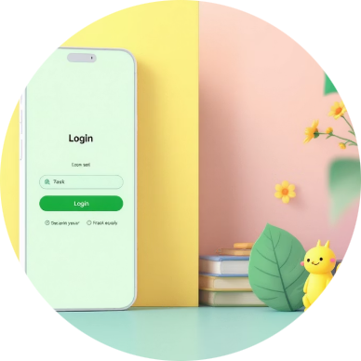

Use Case Diagram Overview
The Use Case Diagram illustrates the functional boundaries of the AEIOU Productivity App by mapping user interactions with system capabilities. It provides a high-level view of what the application does from the user's perspective.
Primary Actors
Core Functions
System Responses
Students, professionals, and freelancers who need structured focus tools
Register, login, add tasks, view lists, start sessions, track progress, receive reminders
Motivation messages and intelligent distraction alerts during active focus periods

Slide 6
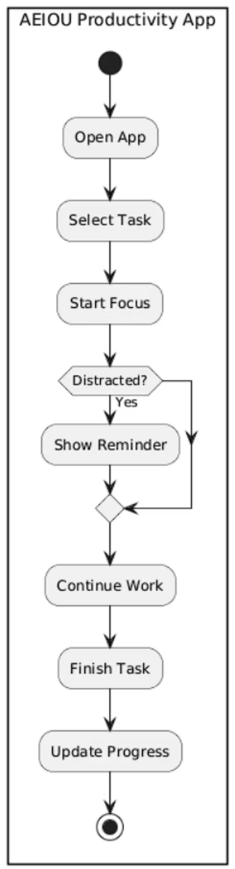
Activity Diagram: User Workflow
This workflow demonstrate
Understanding the Flow
The Activity Diagram represents the step-by-step progression through the AEIOU app during a typical focus session. It captures decision points, system interventions, and the cyclical nature of productivity work.
Key moments include distraction detection, where the system actively intervenes to redirect user attention, and progress tracking, which reinforces positive behaviour patterns.
s the complete journey from task selection through to successful completion, highlighting intervention points where the system provides support.

Slide 7
TECHNICAL ARCHITECTURE
Sequence Diagram: System Interactions
The Sequence Diagram reveals the temporal relationships between system components, showing how messages are exchanged as events unfold during a user session. This technical view is essential for understanding implementation requirements.
Authentication
Focus Session
User opens app → App validates login with database → Session established
User starts session → Timer begins → Notification system monitors activity
1
2
3
4
Task Selection
Completion
User selects task → App fetches details from database → Task displayed
Task marked done → App saves progress → Motivation message displayed

Slide 8
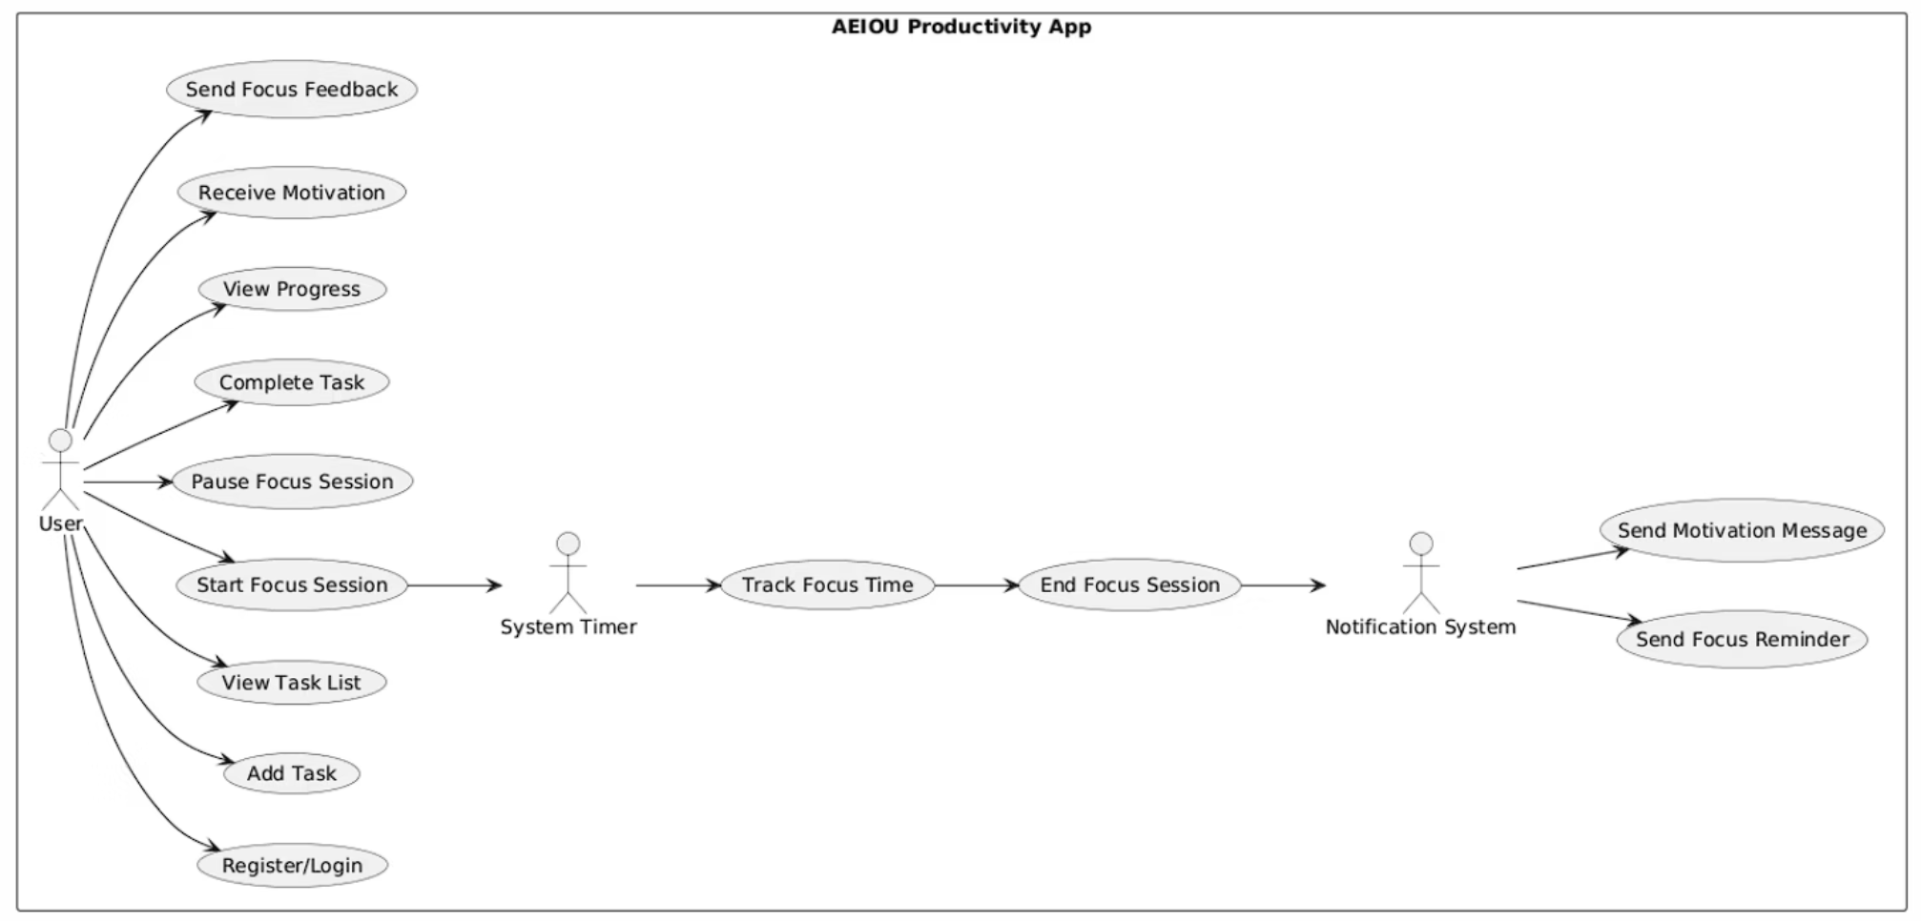
System Components and Data Flow
Participant Interactions
The sequence involves five key participants working in concert:
User initiates actions through the interface
Mobile App orchestrates all interactions
Focus Timer tracks session duration
Notification System sends reminders
Database persists user data and progress
Messages flow between these components in a carefully choreographed sequence, ensuring data consistency and responsive user experience throughout the session.

Slide 9



Project Results
Use Case Diagram
Activity Diagram
Sequence Diagram
Successfully mapped all user interactions and system boundaries
Documented complete workflow from task selection to completion
Illustrated temporal relationships and message exchanges between components
All three UML diagrams for the AEIOU Productivity and Focus App were successfully designed, providing comprehensive documentation of system behaviour, user workflows, and technical architecture. These diagrams serve as essential blueprints for development and stakeholder communication.

Slide 10

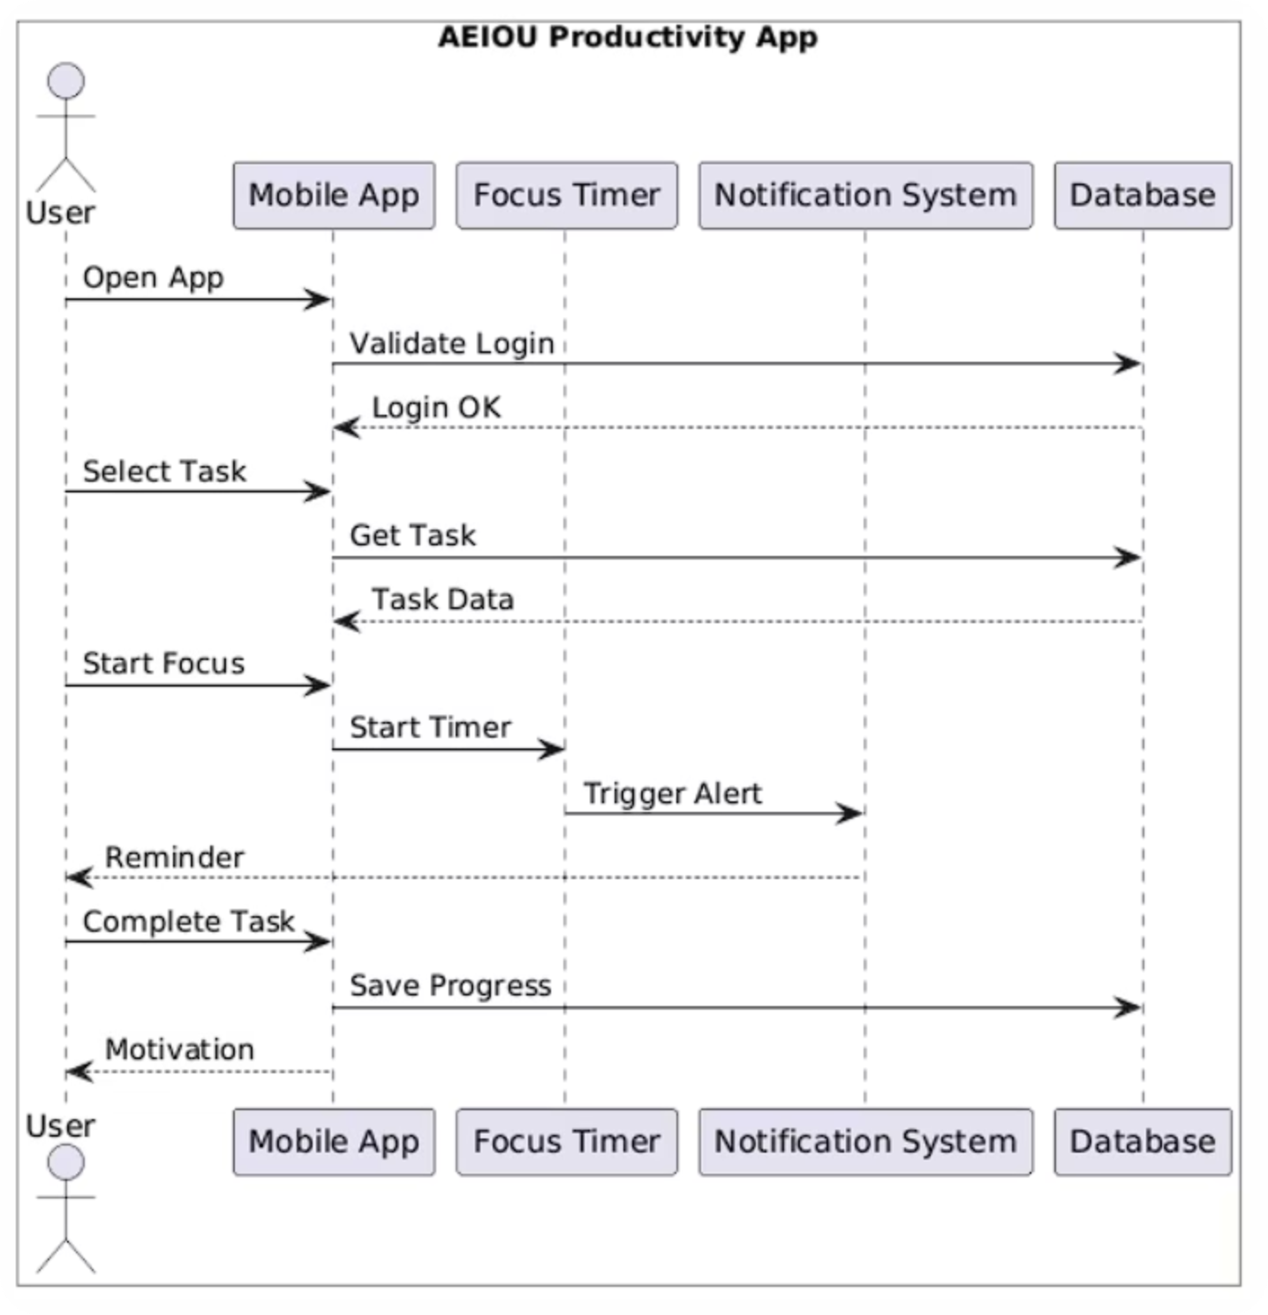

Slide 11


KEY TAKEAWAY
Building Better Focus Habits
The AEIOU Productivity App addresses the critical challenge of maintaining focus in an increasingly distracting digital environment. By providing structured focus sessions, intelligent reminders, and positive reinforcement, the application helps users overcome interruptions and build sustainable productivity habits.
Through careful UML design, we've created a system that improves task execution, reduces procrastination, and supports users in achieving their goals—whether they're students managing coursework, professionals juggling projects, or freelancers building their businesses.
"Consistent focus habits transform productivity from a goal into a daily reality."

